Slide 1
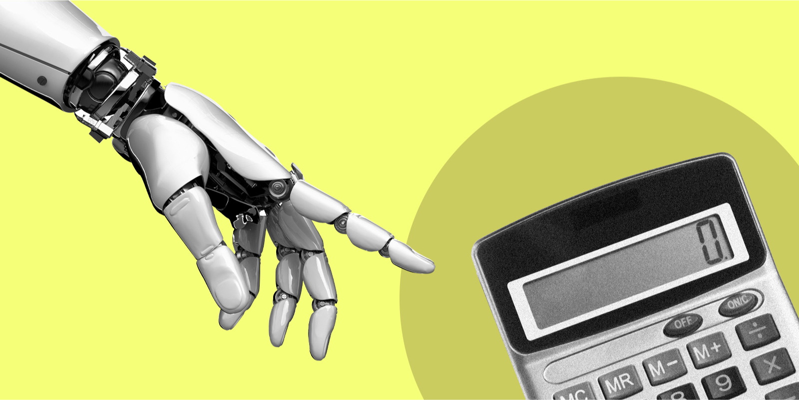
Expense AI
AI Empowered Automated Employee Expense Reimbursement Process
Team 13
Yiwei Wang
Bingyang Ke
Pengkun Ma
Nanxiang Zhao

Slide 2
Why AI Empowered Automated Employee Expense Reimbursement Process ?
Reduce human work
Reduce time cost
Discover fraud
Faster and smarter decision making framework

Slide 3
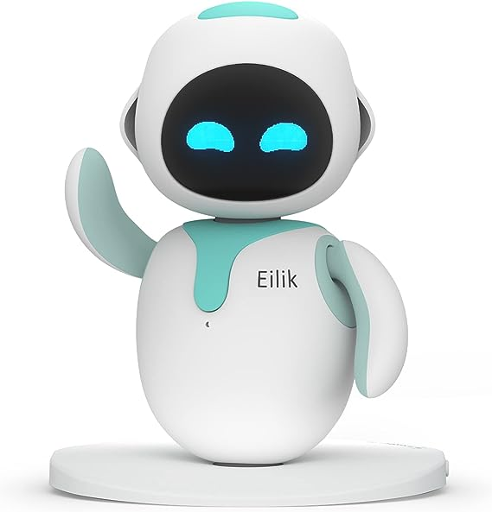
Technique
Machine Learning
NLP
MDP

Slide 4
ML
Data prediction training
inputs
NLP Extract Elements
Customized Feature Extraction / with
Neural Network
Fraud risk predict
MDP
model
Fraud risk score
Decision make

Slide 5
NLP Model
Extract Elements
ML
Predict Future Data
Neural Network
Predict Fraud Risk
MDP
Combine All Information
Inputs
Decisions
Database Stores Data

Slide 6
Extraction elements
?300.00
$300.0
€ 89.55
Jan 20, 2023
20/02/2023
Ergonomic Chairs
Skill Enhancement Programs
$300 in dollars
2023-02-20 in yyyy-mm-dd
Office Equipment & Supplies
Professional Development

Slide 7
Accessing Fraud Risk Score
from invoice text ?
Consider fraud risk factors from invoices Feature Value
Weekend or holiday expenses? 0 / 1
Submitting the same invoice multiple times? 0 / 1
unusual spending - person is not associated on that project? 0 / 1
amount overclaim ? 0 / 1
amount is multiple of 100? 0 / 1
contain personal expense words 0 / 1
Invoice Date falls outside of Project Duration Dates 0 / 1
rounding amounts repeatedly claimed by same person? 0 --1
sudden change in behavior ? 0 – 1
And More……..

Slide 8
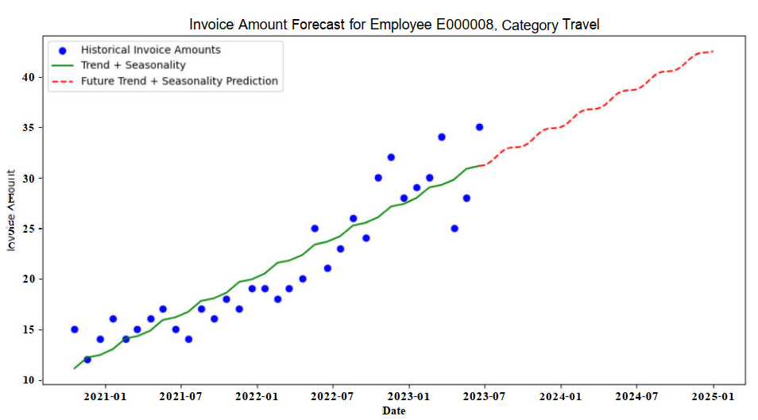
Feature element 8- Sudden change in Behavior?
Predict Future Spending

Slide 9
Fraud Risk Prediction
0, 1
…
0,1,2,3
0~1
[1,0,0,0] [0,1,0,0]

Slide 10
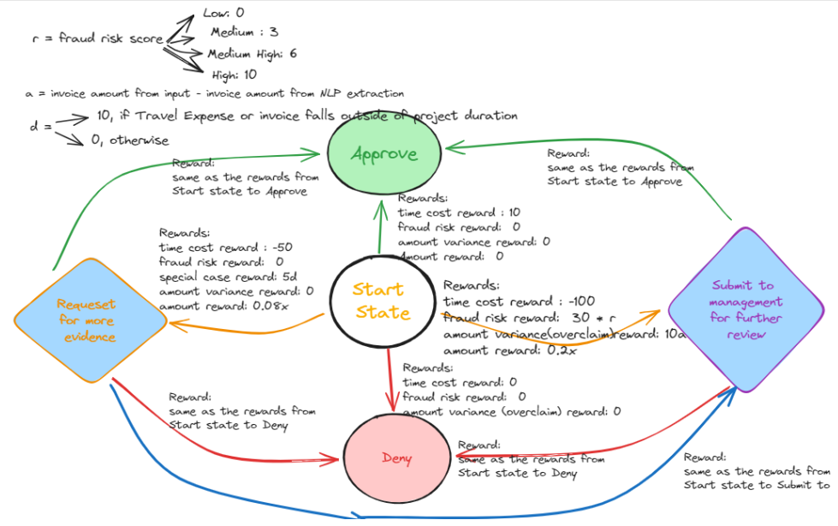
Submit for further review
Request for more evidence
Approve
Deny
start

Slide 11
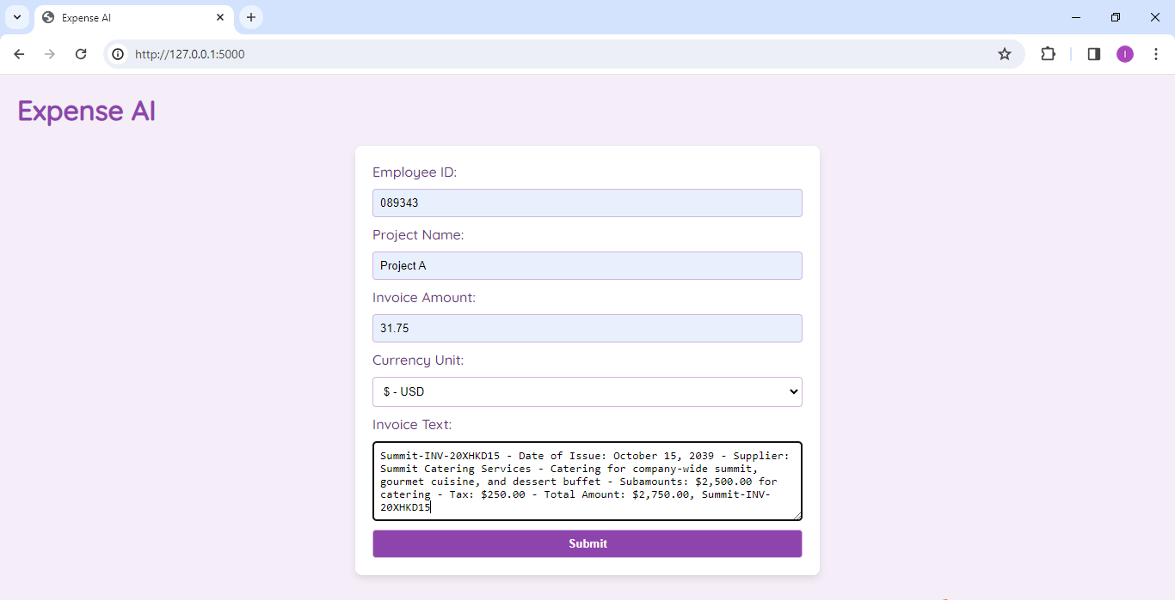
Demo

Slide 12
Future Improvements
Training labels can come from real management’s decisions - Can learn through increased transactions from management’s further review decisions overtime
More factors can influence decision making.
Predictions of future invoice amounts can be more complicated.

Slide 13
Questions ?

Slide 14
Thank you !

